Slide 1

Yelp Spam/Review Detection
Presented By
Hansraj Pabbati (SJSU ID : 012540541)
Rishika Machina (SJSU ID: 012525227)

Slide 2
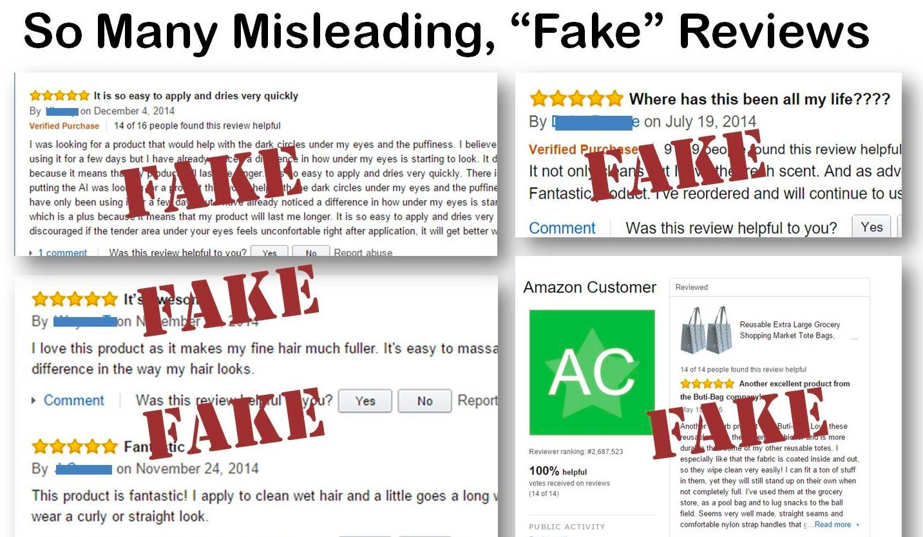
Introduction
Online reviews play a very important role for decision-making in today's e-commerce.
Untruthful review is a fake review or opinion spam
Positive reviews of a target object can attract more customers and increase sales; negative reviews of a target object can result in lower demand and lower sales.

Slide 3



Filtering
Characteristics
Supervised
Unmonitored
Linguistic
Behavioral

Slide 4
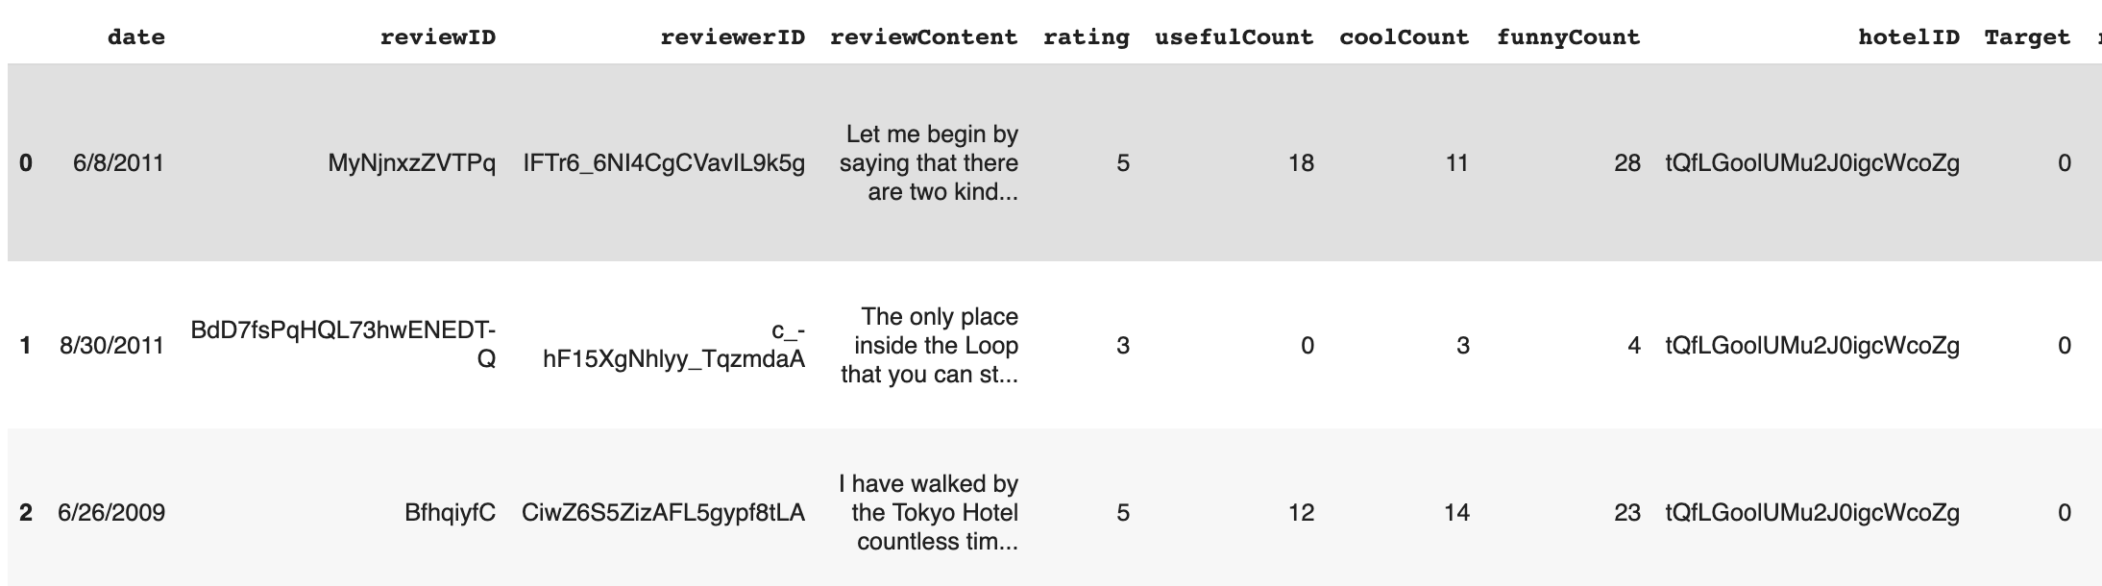

Dataset

Slide 5
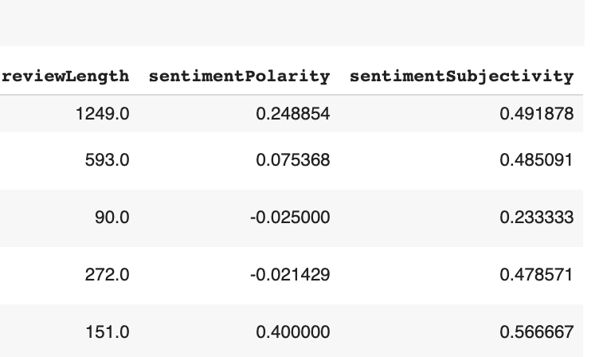
Dataset
Preprocessing: Tokenize reviews (200000-dimension feature vector)
Fabricated features from Review Content
Used Over sampling to balance the classes using XGBoost

Slide 6
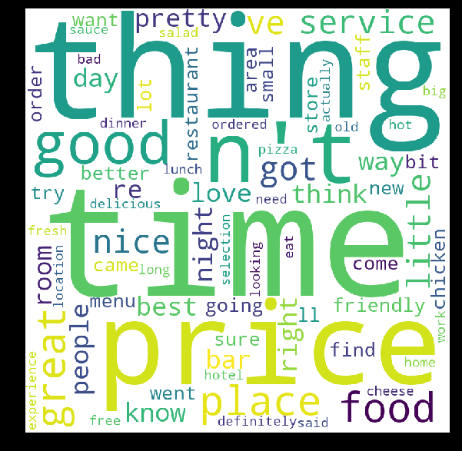
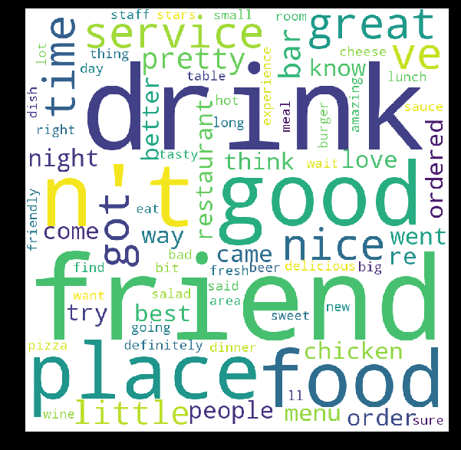
System Design and Implementation
Structural Features - Review Length, Average and standard deviation of review length
Semantic Features – Sentiment Polarity
N-Gram - Unigram, Bigram and Trigram

Slide 7
Preprocess the data, replace the missing values, Oversampling
Train the data using different algorithms
Check for accuracy by tuning various parameters and cross validation
Test on unseen data
Compare the accuracy
Save the model, so that it can be directly used next time
Choose the best model

Slide 8
Data Preprocessing and Feature Engineering
Train – Test Split 80-20 percent with 5 fold cross validation
Tokenize using Spacy and Keras
Removal of punctuations , convert to lowercase, Regex
Removal of Stopwords
Tokenization and Lemmatization
Vectorizer and TF-IDF
Word Frequency and Word cloud
Sentiment Polarity and Sentiment Subjectivity

Slide 9
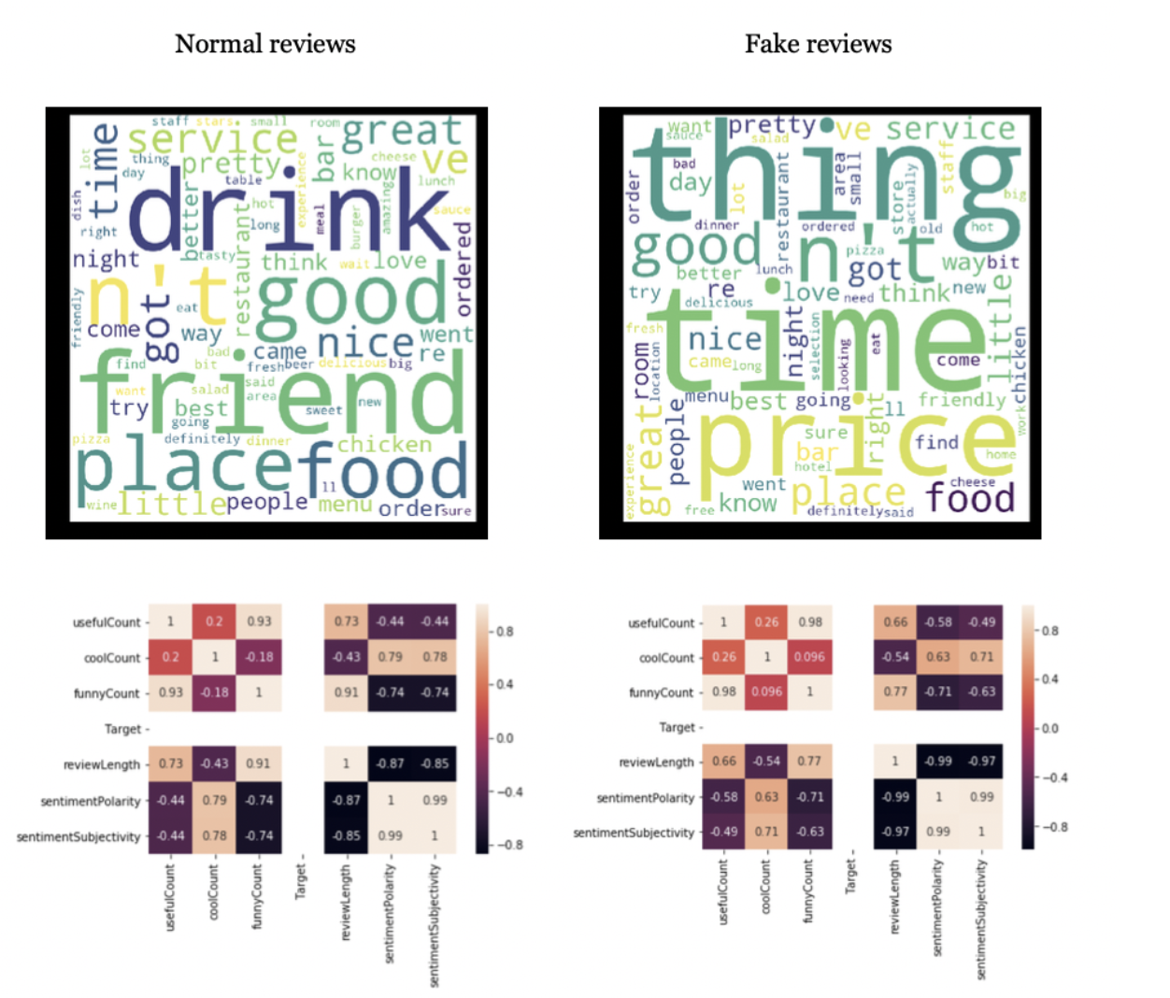
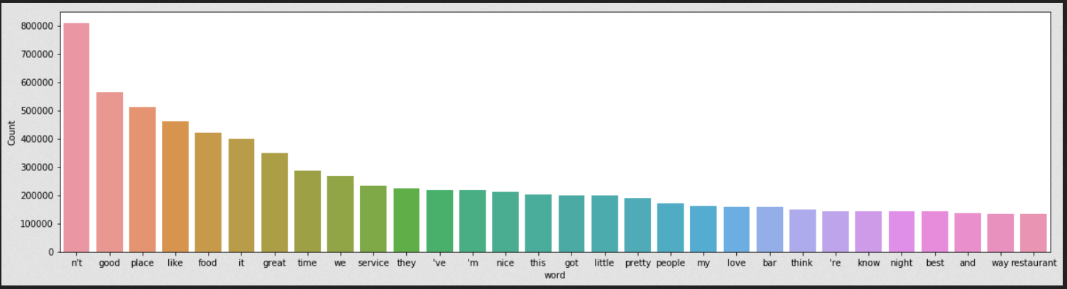
Word Cloud
Most Frequent Words
Heat Map to find Correlation

Slide 10

Multinomial Naïve Bayes
Trained on Review Content initially
Gave decent results, so to improve it further used Grid Search
Performed Grid Search with following parameters-'vect__ngram_range': [(1, 1), (1, 2)], 'tfidf__use_idf': (True, False), 'clf__alpha': (1e-2, 1e-3)}
Best Parameters obtained : ngram_range':, (1, 2),
Tfidf__use_idf : True, clf_alpha : .0001.
5 – fold cross validation

Slide 11

Random Forest
501 estimators
balanced class weights - Imbalanced dataset
Bootstrap aggregation
CART - Gini Index
ID3 - Information gain

Slide 12
Neural Networks
Neural Network with LSTM | Neural Network with extra 1D CNN on top of LSTM layer | Neural network with Bidirectional recurrent layers | Neural network using RNN with GRU
Embedding layer, LSTM layer, and output of LSTM Layer was fed into hidden fully connected layer | Combination of recurrent neural network with LSTM and Convolutional layer | Frequently used for NLP for richer data representations | Trained with padded sequence
10,000 most common words were used as features | Dropout layer was added after embedding layer and convolutional layer | Bidirectional recurrent layer after embedding layer | Need to change weight matrices so recurrent unit provides output for input sequence
20 percent dropout, 0.2 Validation split | 20 percent dropout, 0.2 Validation split | Separate instance of this layer for chronological processing and reversed order processing | 5 percent validation split

Slide 13
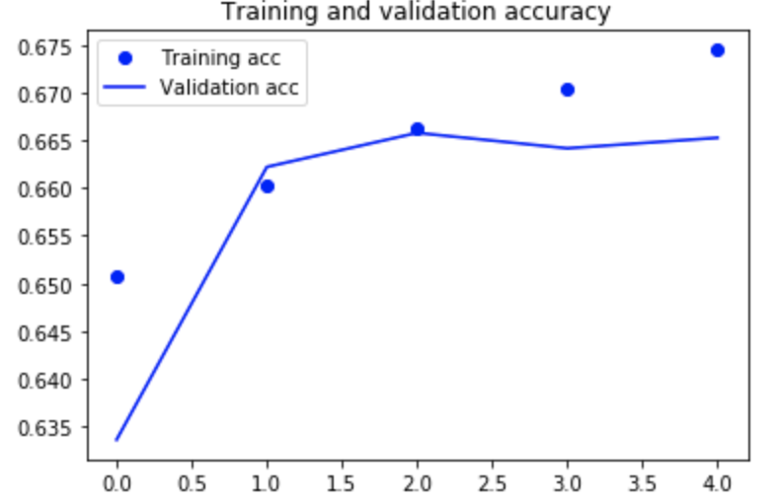
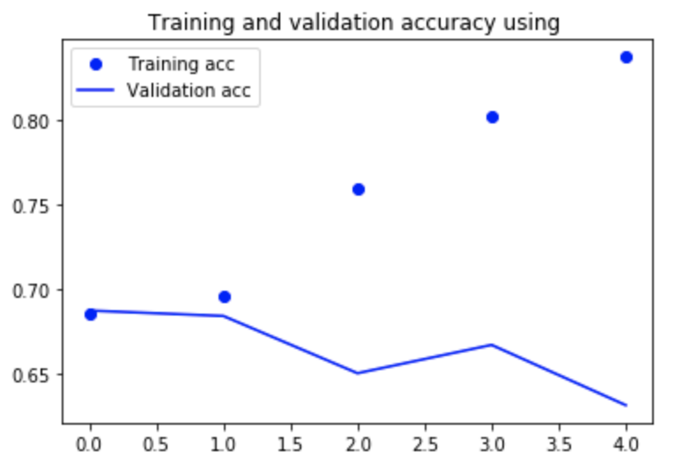
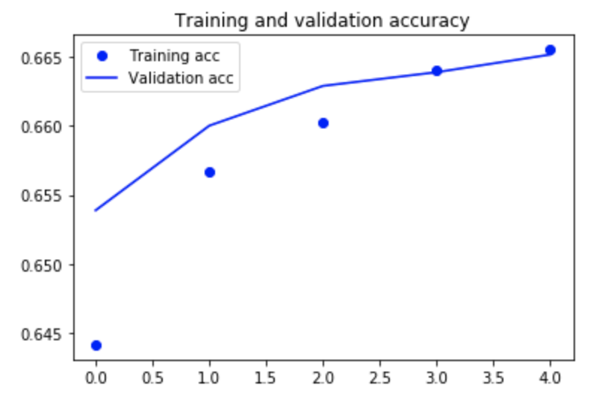
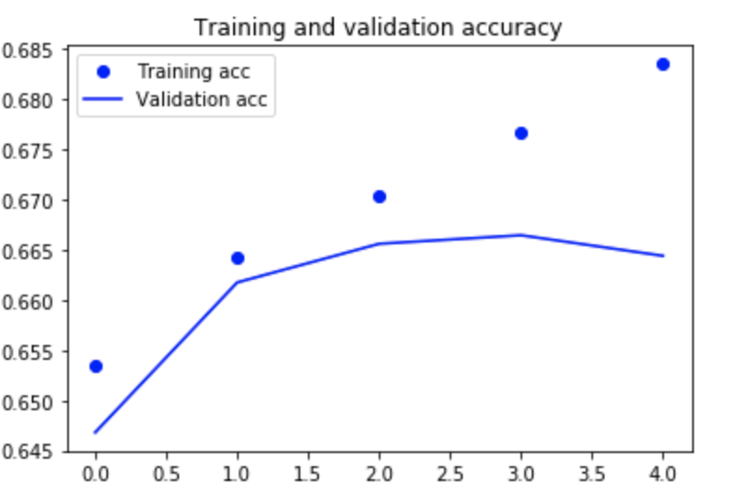
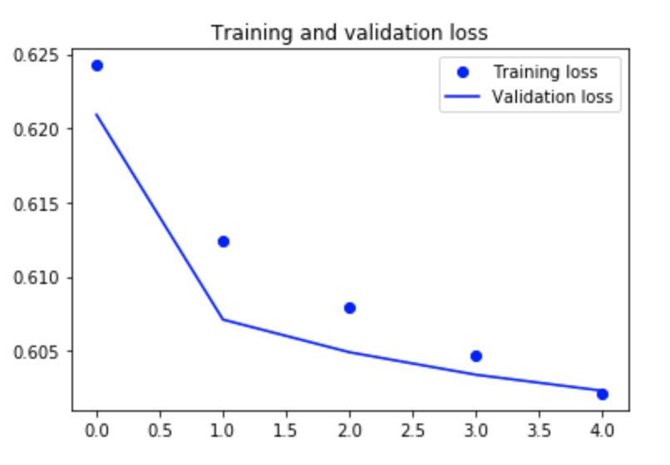
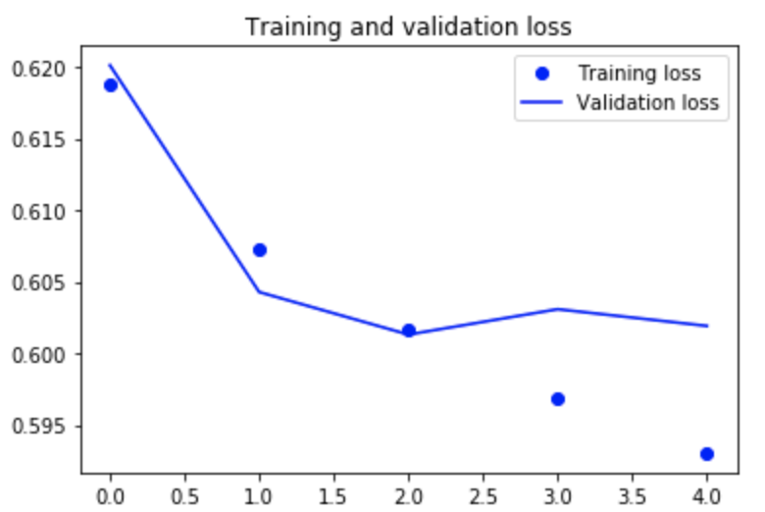
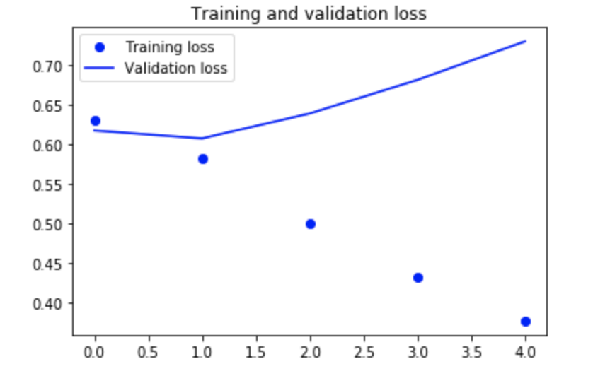
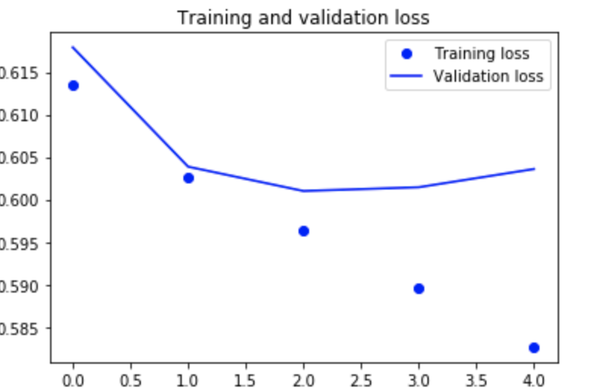
Neural Network with LSTM | Neural Network with extra 1D CNN on top of LSTM layer | Neural network with Bidirectional recurrent layers | Neural network using RNN

Slide 14
Evaluation of Results
 | Classifier | F1 Score
1 | Naive Bayes Classifier | 63.52 %
2 | Naive Bayes Classifier (With Grid search and ngram) | 70.00 %
3 | Neural Network with LSTM | 66.26 %
4 | Neural Network with 1D CNN on top of LSTM layer | 66.39 %
5 | Neural Network using Bidirectional recurrent layer | 66.45 %
6 | Recurrent Neural Network with GRU | 70%
7 | XGBoost | 64% (Text), 57%(Other)
8 | Random Forest | 33%

Slide 15
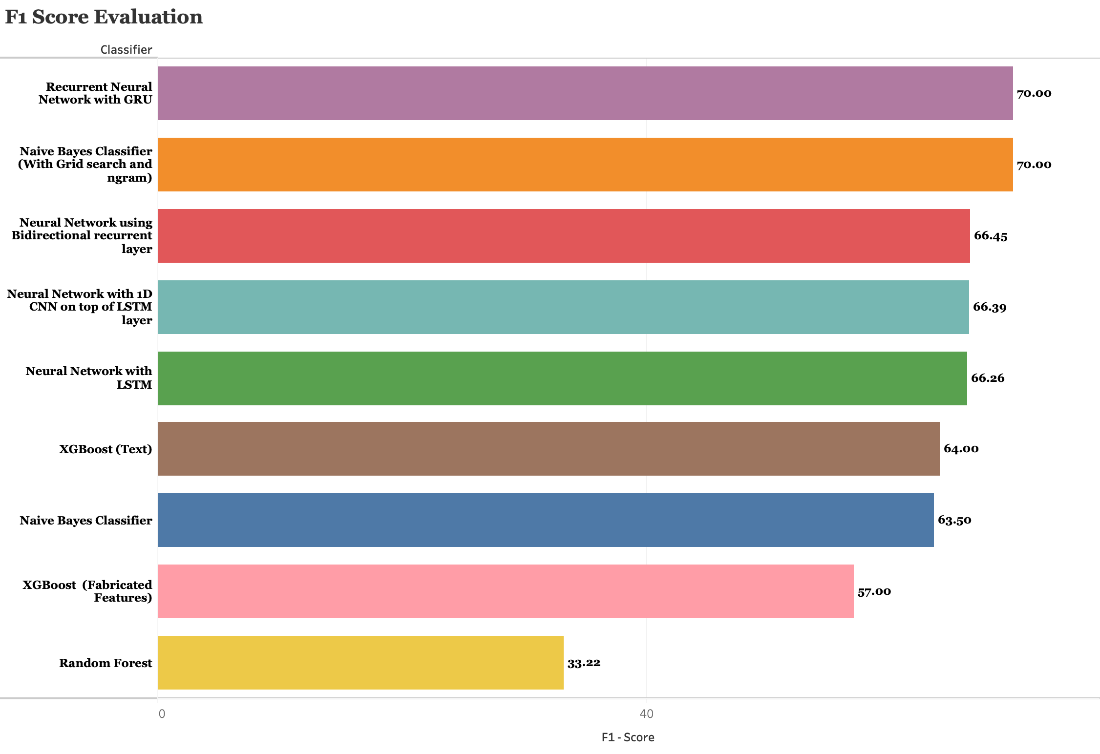

Slide 16

Conclusion
No major improvement with reviewer centered fabricated features.
Using simple approach works best.
Multinomial Naïve Bayes gave the best accuracy of 70 percent with Grid search.
RNN with GRU also gave 70 percent accuracy

Slide 17

Thank you

